Slide 1
Introduction to Add-Ins and Office 365 Developer Patterns and Practices
Vesa Juvonen
Senior Program Manager
Office 365 Engineering, Microsoft

Slide 2

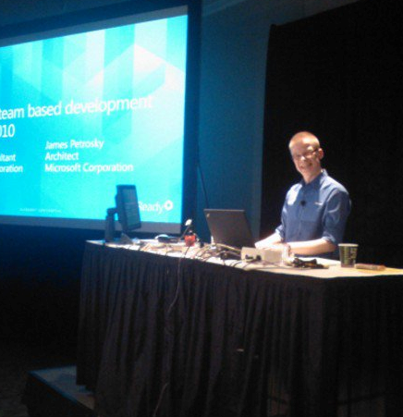



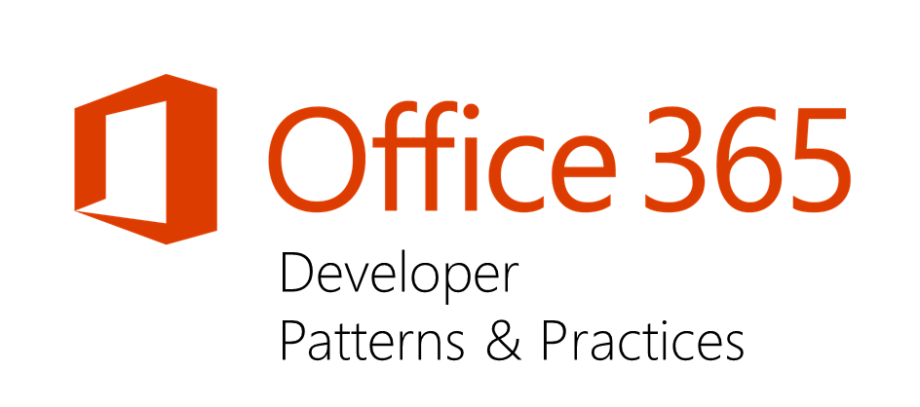
Vesa Juvonen
Pre-Microsoft
Entrepreneur, ICL, Fujitsu, Basware
Microsoft (2006-)
Senior Program Manager, Office 365 CXP CAT
Principal Consultant for 8 years before moving to PG
Office 365 Dev Patterns and Practices program lead
JDP program technical lead
SharePoint MCM/MCSM Instructor & Content Owner
Instruction cross 18 rotations from start to finish of the program
Contact
Email – vesa.juvonen@microsoft.com
Blog – http://blogs.msdn.com/vesku
Twitter - @vesajuvonen
Passion for the cloud
It’s Finglish…
Doing the heavy lifting…

Slide 3

Agenda
Introduction what we do in Microsoft
Learnings from our work
Development recommendations

Slide 4

"The most strategic developer surface area for us is Office 365“ - Satya Nadella
Notes:
Why?
The key to enterprise productivity going forward
Microsoft’s strategic advantage in the Enterprise
Partners and Developers are key to its success

Slide 5
Developer vision
USERS
DATA
HTML
Notes:
Our Office 365 developer vision focuses on the Users’ experience and their data. As a developer you can bring your applications into their user experience. With over 1.2+ billion users of Office Worldwide, this is a huge opportunity to provide a window into your applications. As well as being able to connect into their data and add intelligence to your applications. There are currently 850 million events created a month and a total of 470Pb+ of data stored in the service that can add value to for our Users’.

Slide 6
App model = Add-in model
Marketing terminology change done spring 2015, which was only done for marketing messaging purposes.

Slide 7


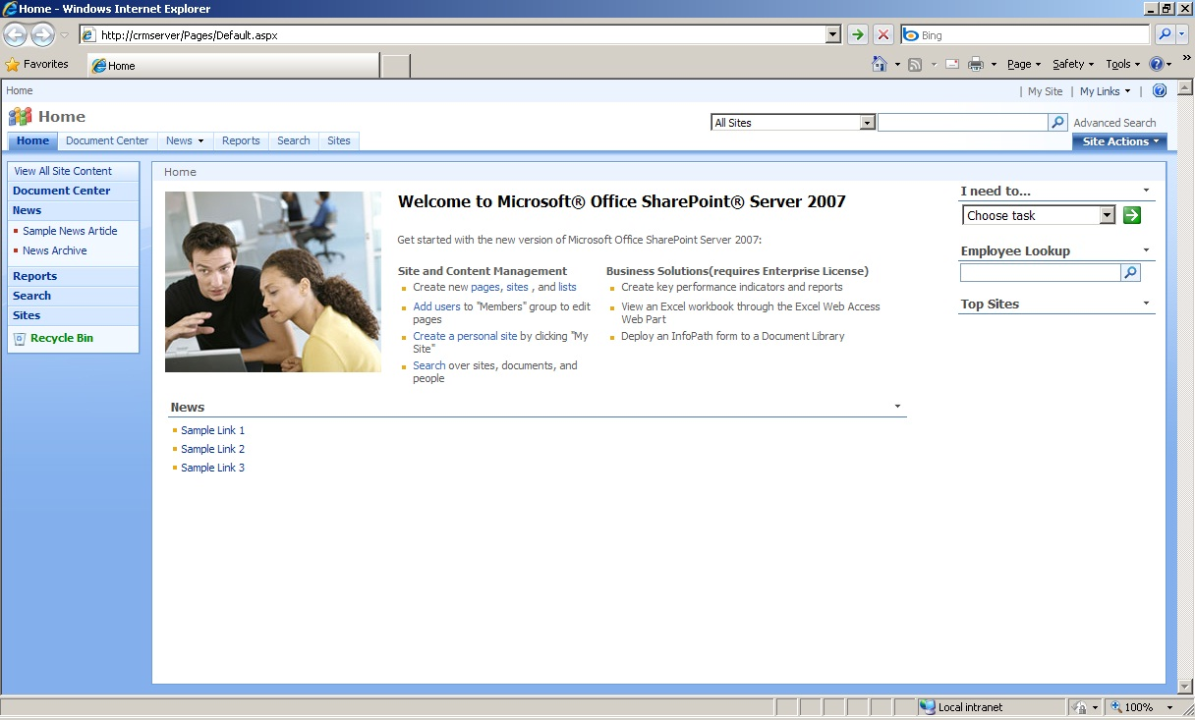
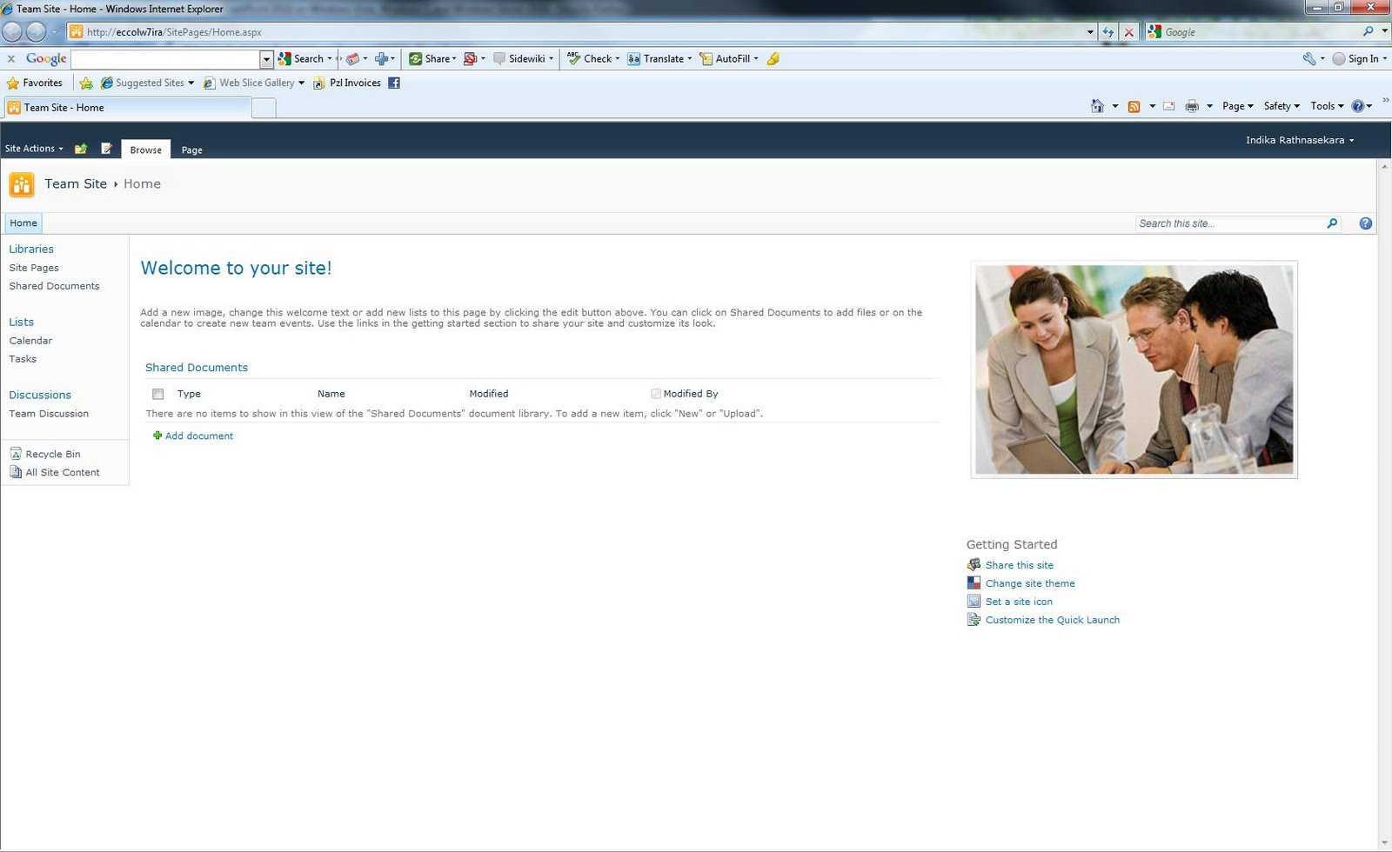
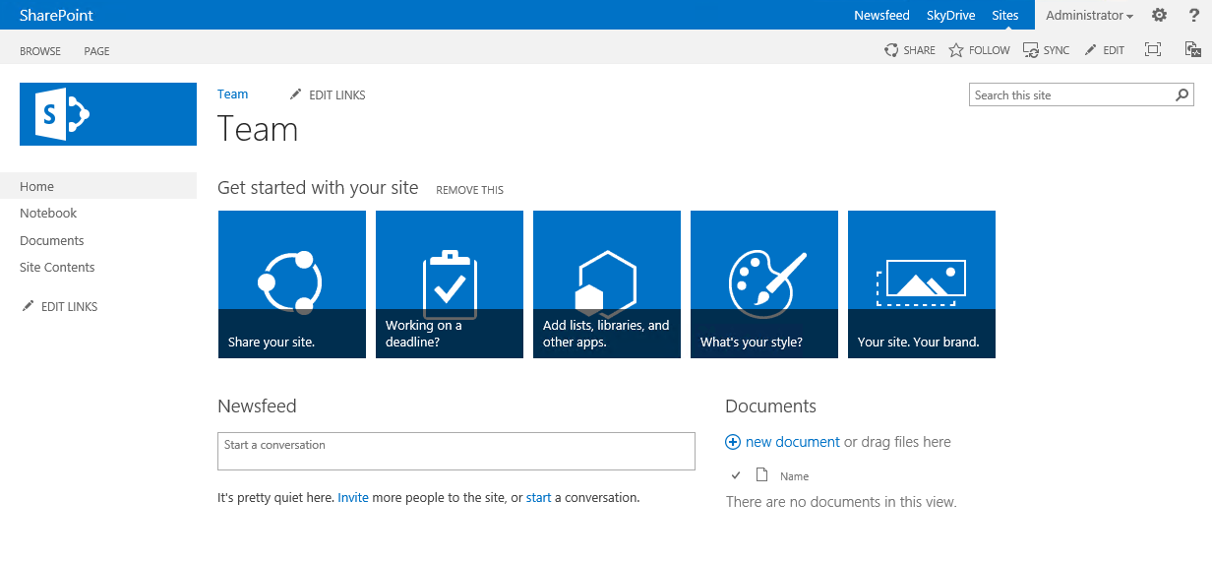
SharePoint evolves…
Provider Hosted Add-Ins
C#
SharePoint 2007
SharePoint 2010
C#
SharePoint 2013
C#
Sandbox
_api
C#
JS
JS

Slide 8





Approaching app implementations
Readiness
Assessment
Planning
Implementation
Deployment
Readiness with app model topics
Hosting decisions
Network impact analysis
Development model readiness
Analyze possible existing solution usage, including both code and functionality
Concentrate on business and functional requirements, not on technology
Add-In model solution planning and design
What patterns and models are used for different solutions
What solutions can be converted to out of the box capabilities?
Detailed technical planning
Actual app model solution implementation
Typical development process, including testing
Add-In solution deployment
Existing content retrofitting
Farm solution retraction
Time for accurate estimates

Slide 9
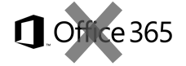
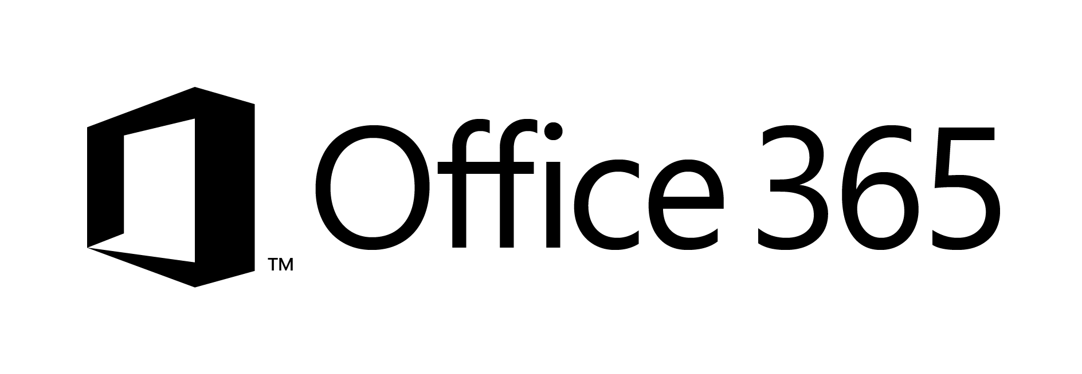

What does add-ins mean in our terminology
SharePoint Add-Ins means all operations which are executed outside of the server
Classic - Full trust solutions
ISV solutions
Client Side Solutions
Remote provisioning for elements
Store apps
App catalog based solution
Custom service applications
Custom WCF services
Platform level customizations to on-premises
Server side controls as JavaScript on page layouts and master pages
Embracing un-ghosted model
SP App dimension with provider hosted apps to provide new capabilities
Packaged reusable solutions built for specific functionality
SharePoint customizations, not customer specific customizations
Customer specific customizations
Not only for market place or store, but also as platform for customer specific customizations

Slide 10
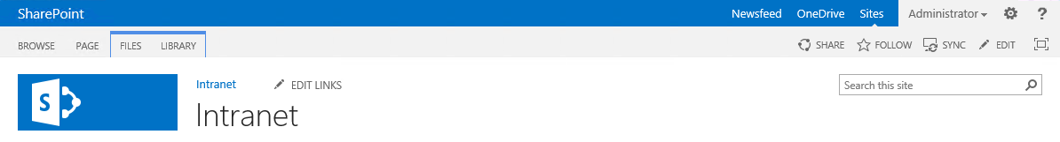
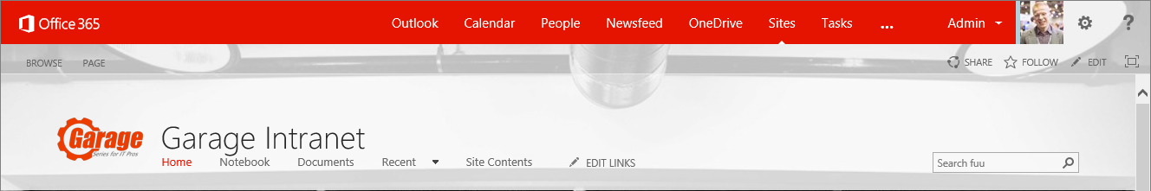
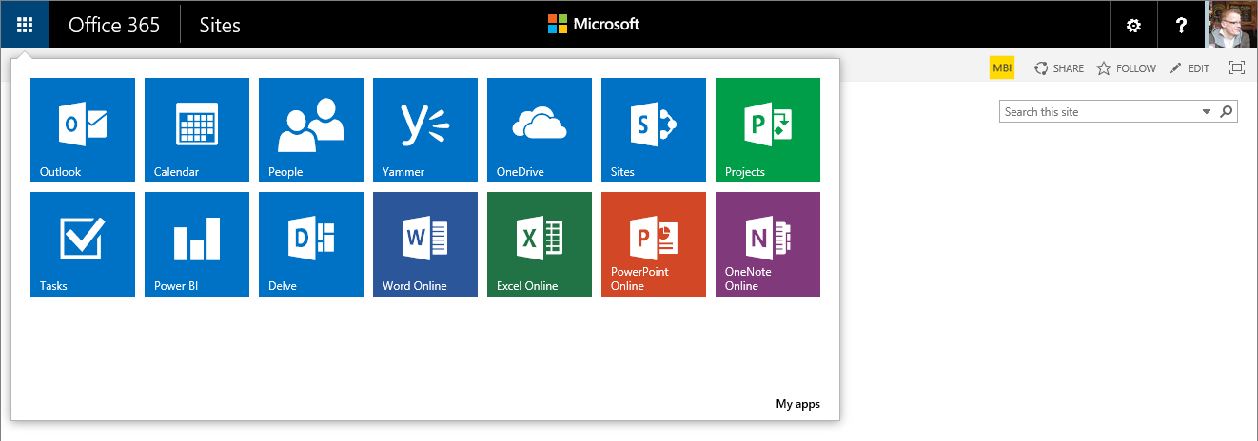
Constant evolution of user experience
Notes:
App launcher

Slide 11
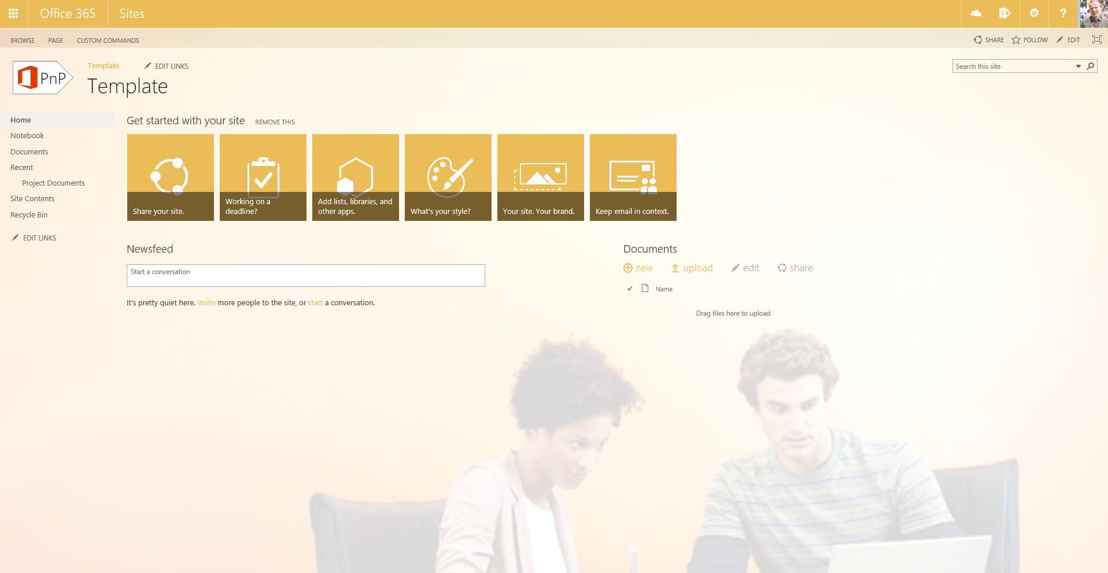
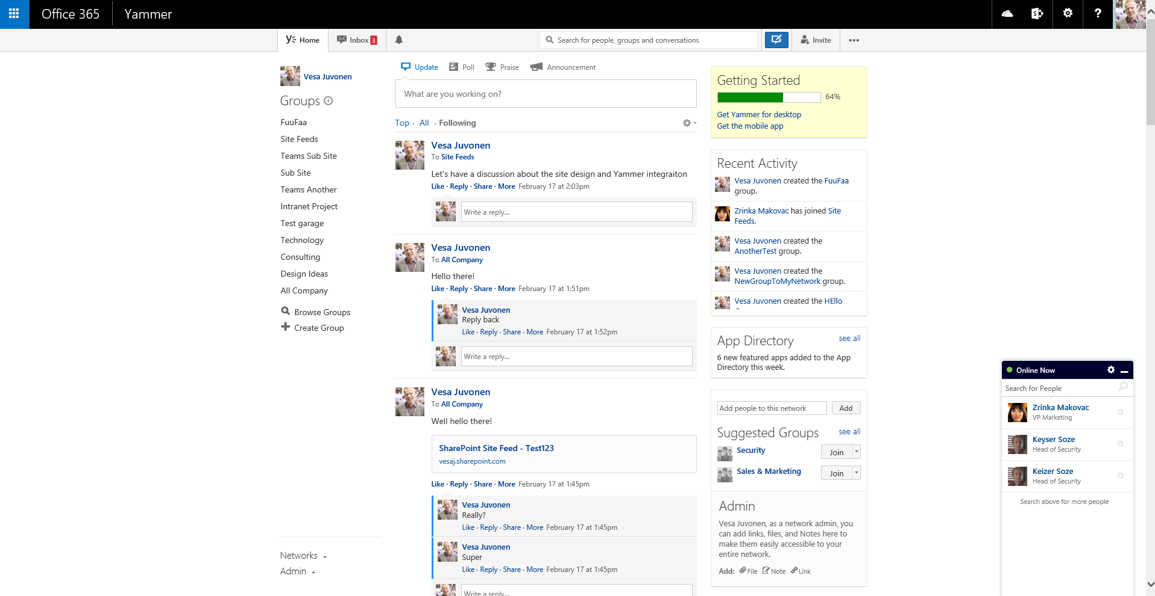
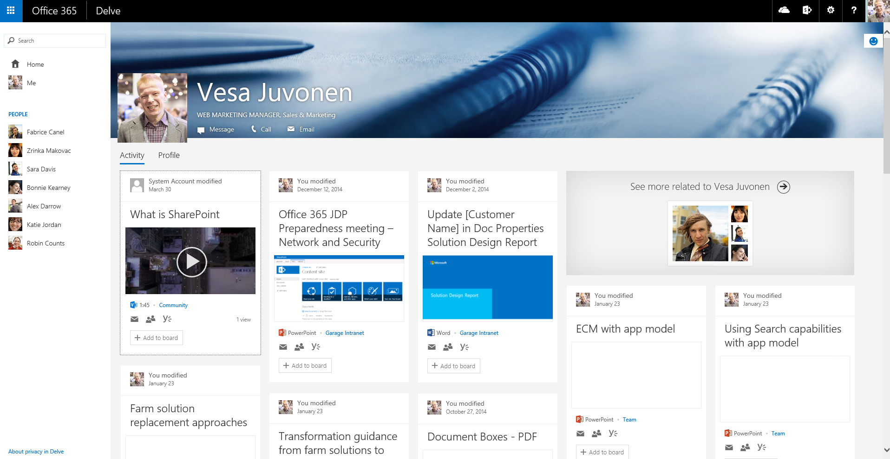
Office 365 is not just about SharePoint

Slide 12
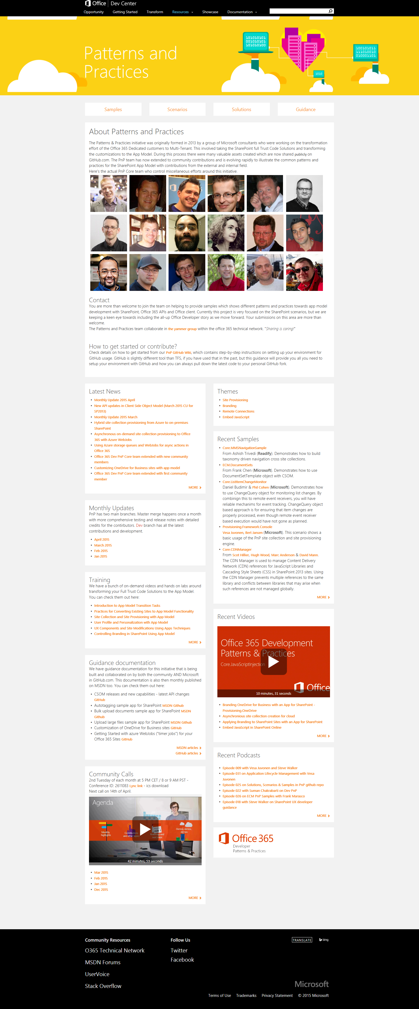
“Sharing is caring”
aka.ms/OfficeDevPnP
aka.ms/OfficeDevPnPYammer
aka.ms/OfficeDevPnPMSDN
aka.ms/OfficeDevPnPVideos
aka.ms/OfficeDevPnPTraining

Slide 13
Quotes from community survey
“One of the greatest things done to devs.”
“The PnP stuff is really useful and very much appreciated”
“I think the PnP is an awesome program”
“Amazing effort by the team from both MS and community members!”
“A good model that other Microsoft projects should implement too”
“Office PnP is by far the most collaborative and open forum I have ever seen in my 15 years working with Microsoft.”
“This is the most valuable resource for developers Microsoft has ever produced.”

Slide 14

aka.ms/OfficeDevPnP
Take advantage of the add-in model
Providing App Model Patterns for common scenarios Open source and based on community contributions Constantly evolving set of material for reuse
100+ Visual Studio projects
Common scenarios Branding guidance Site provisioning Remote timer jobs
UX components Taxonomy driven navigation And much more…
Patterns and Practices Yammer Group - http://aka.ms/officedevpnpYammer

Slide 15

O365 Dev Patterns and Practices model
Community
Engineering input for API changes
Core component(s)
Training
Presentations
Internal programs
Guidance / MSDN
Seminar materials
Engineering input
Videos
Other assets

Slide 16
Best practices

Slide 17
Best practices for add-in model
#1 – Use remote provision for site templating and to push configurations to sites
#2 – Avoid custom master pages, if possible
#3 – Avoid feature framework and sandbox solutions
#4 – Use “remote timer job” pattern for scheduled and batch oprations
#5 – Take advantage of the add-in model in both on-premises and in Office 365

Slide 18
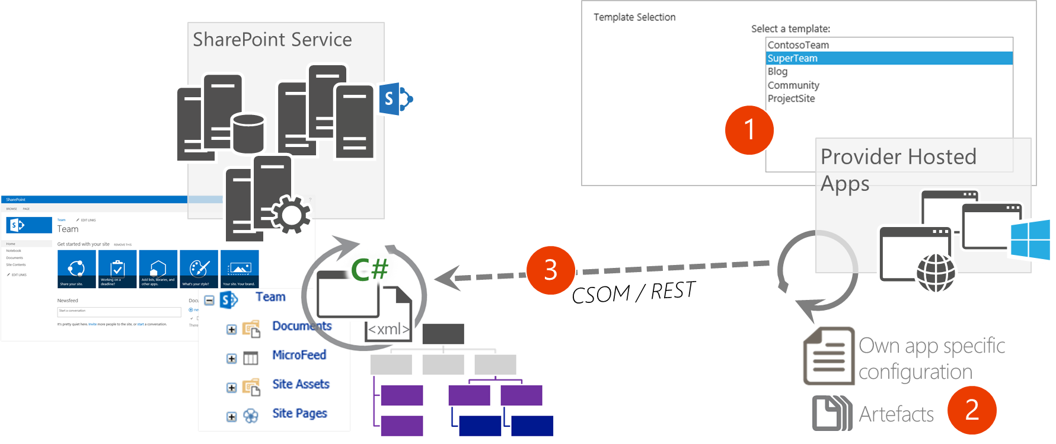
#1 – Remote provisioning
Provision site collections and sub sites remotely to provide different templates
Provider hosted, PowerShell, Console applications
All artefacts and customizations are pushed to the sites using remote APIs

Slide 19
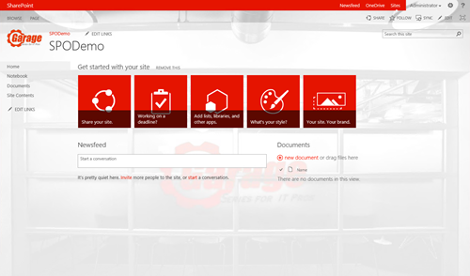
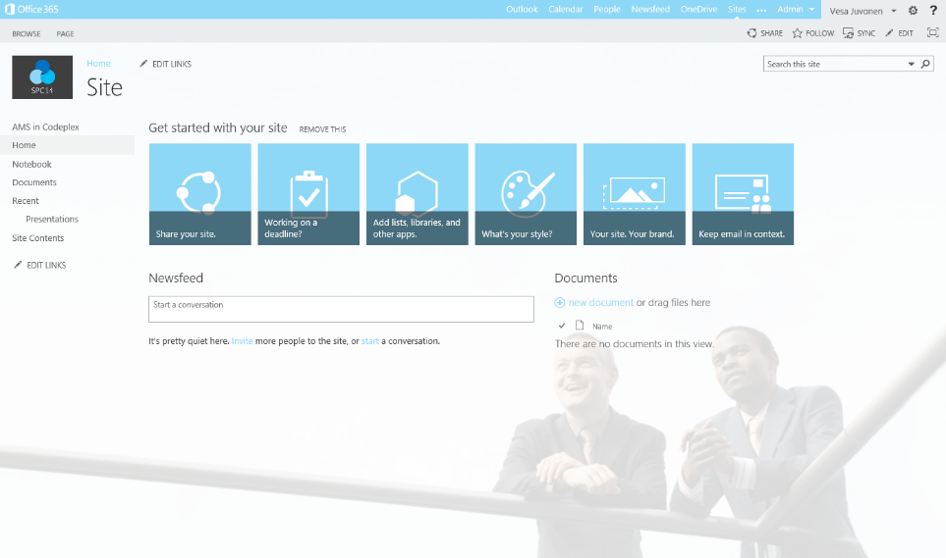
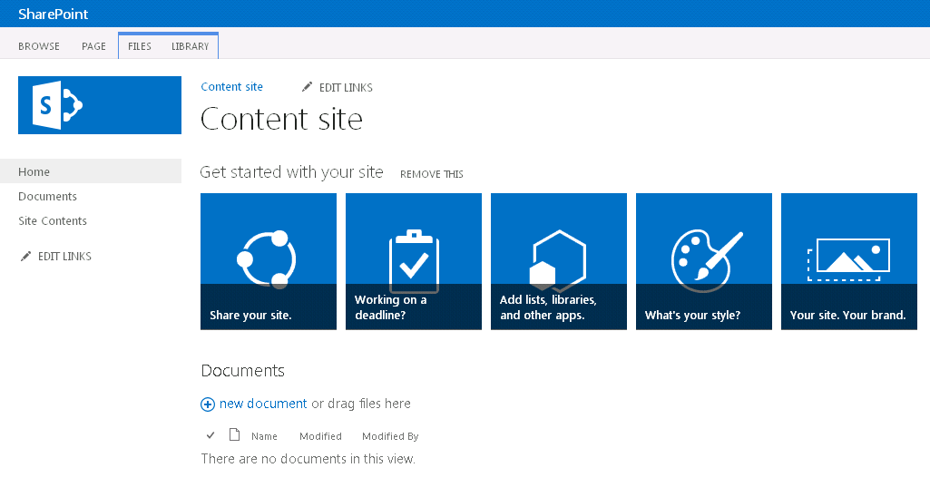
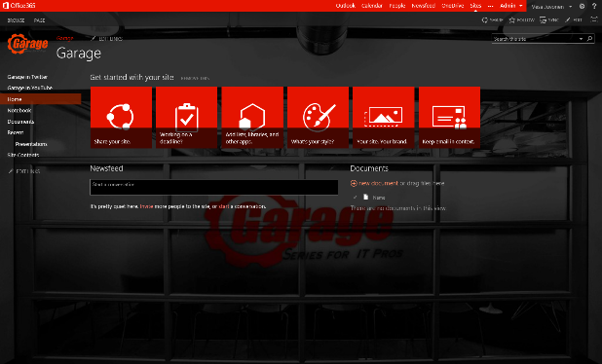
#1 - Provisioning time logic
Initial provisioning based on the out of the box site. Usually either team site or publishing site.
Assets are uploaded from the provisioning engine using CSOM/REST
3
Project site
1
2
Remote timer job
3
Organizational
Assets and configuration
Apply the needed changes (configurations etc.) on top of the out of the box site based on the user selection.
This is the specialization part, but since we start from oob site, we always get the latest improvements to it as a base line.
Branding Images
JavaScript files
Page Layouts
Other settings
3
Workgroup
Notes:
Vesa

Slide 20
PnP Provisioning Engine
Framework for easily doing Remote Provisioning
Part of the OfficeDev PnP Core component
Object oriented engine for easy and fast Remote Provisioning
Capabilities
Automated Remote Provisioning
Easy Site Template Generation/Extraction
Available in Microsoft .NET
There are PowerShell extensions for common tasks
Export/Import of templates in a formatter-independent manner
XML Schema
JSON
Whatever else…

Slide 21
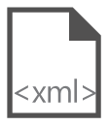
Site provisioning framework
C#
1
// Get template from existing site
template = ctx.Web.GetProvisioningTemplate();
Site A
XMLFileSystemTemplateProvider
2
// Save template using XML provider
XMLFileSystemTemplateProvider provider =
new XMLFileSystemTemplateProvider(@"c:\temp\", "");
string templateName = "template.xml";
provider.SaveAs(template, templateName);
// Load the saved model again
ProvisioningTemplate p2 =
provider.GetTemplate(templateName);
Connectors
XMLAzureStorageTemplateProvider
3
4
Site B
XMLSharePointTemplateProvider
// Apply template to existing site
ctxTarget.Web.ApplyProvisioningTemplate(template);

Slide 22
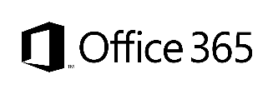

#2 - Branding
Custom Master Page
Alternate CSS
Theme
Office 365 Themes
Full control on how the site is rendered
Applied to each site, except for publishing sites
Any updates to oob master pages are not automatically reflected on the sites
Can be used to override whatever CSS settings
Control to color, fonts and even layout settings
Configuration applied to each site
Can be used to control branding, fonts and background image of the sites
Configuration applied to each site
Can be used to centrally control branding cross all services in the Office 365
Limited settings currently
Can be overridden in site level
Only in Office 365, not in on-premises
Options
Support
only
Flexibility
Unlimited
Good
Average
Fair
Cost impact (short and long term)
Notes:
Vesa & Steve Dialog

Slide 23
#3 – Avoid sandbox solutions
Code behind sandbox solutions are deprecated
Shows the direction where we are heading
No centralized control for sandbox solutions
No enterprise level capabilities for controlling available solutions
Possible orphan issues with deactivation
Still based on feature framework with it’s caveats
“We deployed custom default.aspx and now things are broken”
Requires deep understanding of SharePoint’isms
Update operations will require code anyway
Notes:
Steve
Time: 13:00

Slide 24
#4 - Remote timer job
Scheduled execution which accesses the needed resources from the SharePoint service and performs the required automation.
Can use either specific account for connection or oAuth based app-only token approach
SharePoint Service
2
Provider Hosted Apps
1
Remote timer job

Slide 25
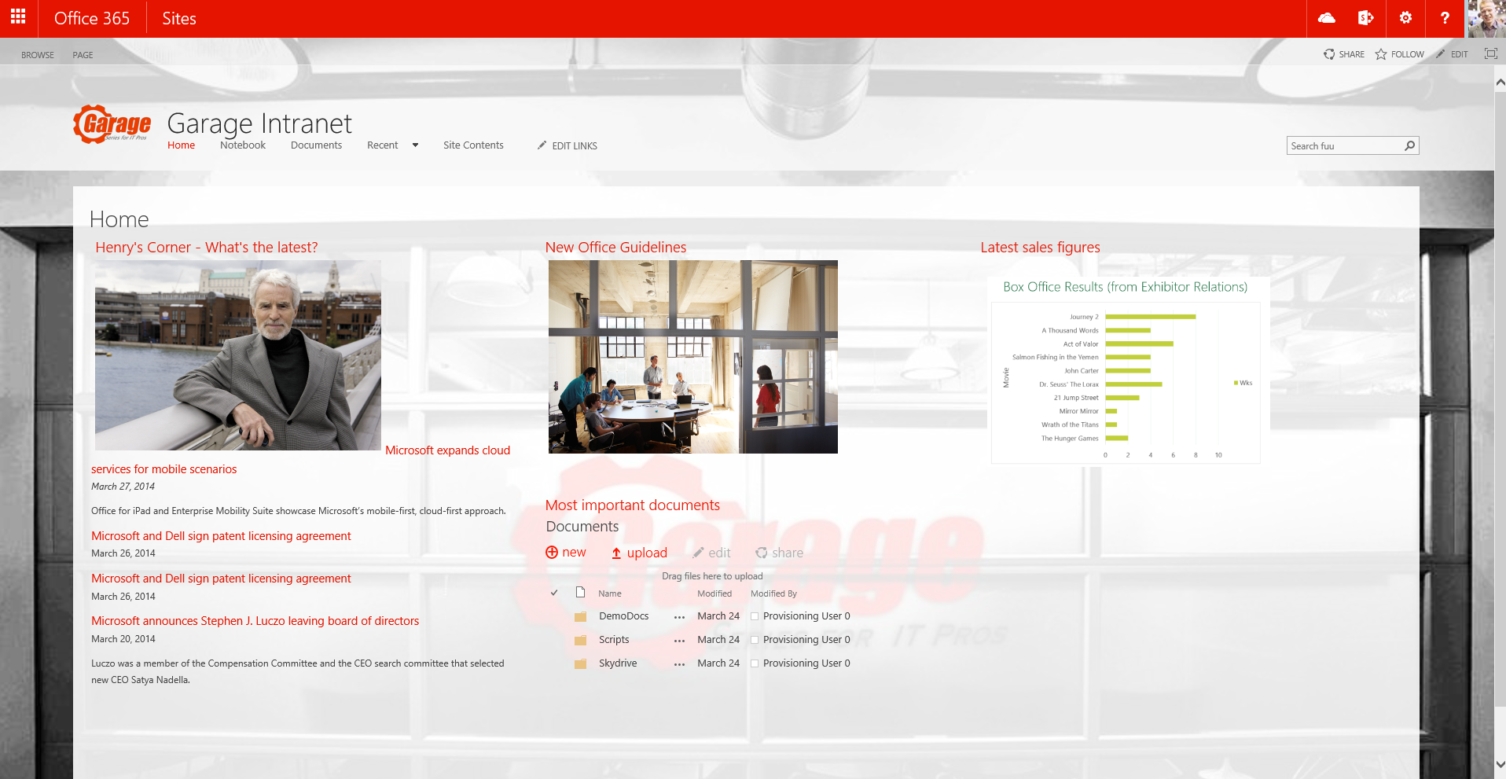
#4 - Asynchronous pattern with WebJobs
Provider Hosted Apps
2
SharePoint
<<Run app functionality>>
<<Add message>>
1
Storage Queue
3
<< Perform needed actions>>
<<instantiate>>
WebJob
4

Slide 26
#5 – Add-in model for on-premises
Write once, use it in both worlds
Add-Ins recommended model for on-premises as well
Add-in development can be similar as with Office 365 with one time configuration for local farm
No additional headaches with certificates and developers do not need to understand insights of token model
Provider hosted as the preferred model
Requires 2 new servers like Office Web Apps since SP2013 release

Slide 27

Questions?

Slide 28


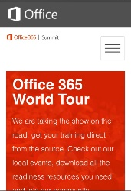
dev.office.com
Sign up
http://dev.office.com/getting-started
Explore
http://apisandbox.msdn.microsoft.com
Get trained http://dev.office.com/training

Slide 29


Feedback
Office 365 Network Share you best practices and join conversations
https://www.yammer.com/itpronetwork
Stackoverflow Ask deep technical questions to a world-wide set of developers
http://stackoverflow.com/questions/tagged/ms-office
UserVoice Provide suggestions of what you want in future versions
http://officespdev.uservoice.com/

Slide 30
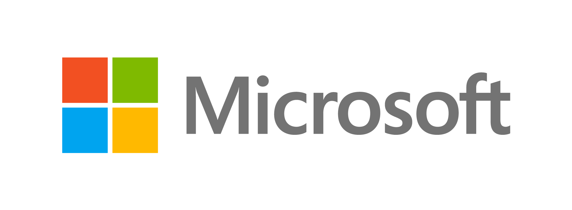

© 2015 Microsoft Corporation. All rights reserved. Microsoft, Windows, and other product names are or may be registered trademarks and/or trademarks in the U.S. and/or other countries.
The information herein is for informational purposes only and represents the current view of Microsoft Corporation as of the date of this presentation. Because Microsoft must respond to changing market conditions, it should not be interpreted to be a commitment on the part of Microsoft, and Microsoft cannot guarantee the accuracy of any information provided after the date of this presentation. MICROSOFT MAKES NO WARRANTIES, EXPRESS, IMPLIED OR STATUTORY, AS TO THE INFORMATION IN THIS PRESENTATION.

Slide 31
PnP - Added value

Slide 32
PnP Value - Architect
Microsoft engineering sanctioned solutions for common scenarios
Thoroughly integration tested extensions
Monthly releases through NuGet for PnP Core component
Save time and mental capacity
Notes:
MS sanctioned solutions to solve common problems/scenarios, can save a lot of development time. Thouroughly integration tested extensions with montly NuGet releases.
I check solutions/samples before google when not sure about the best approach. It has worked out really well in my previous 1 year long project.
Things from Core can trickle up into the CSOM api. SetSiteLogo turned up as web.SetSiteLogoUrl.
Deprecated when happens.
In future – Deprecation will state when deprecation will happen.
Keep it up to date

Slide 33
PnP Value - Developer
Core - Less boilerplate, DRY, trust the code quality
Opportunity to contribute back to the community
Samples – Show specific patterns and how to enable typical customizations using add-in model
Notes:
Core - Write less boilerplate code. Trust the code that is written
Opportunity to share fixes back to the community (note: needs customer approval).
DRY / Don’t' reinvent the wheel. Focus on building solutions that provide value

Slide 34
PnP Value - Business
Save money. Sometimes a lot of money
Proven practices used by other customers as well
Majority of the patterns are coming from real customer engagements
Notes:
PnP can save you a lot of money. This is where a lot of the best practices are formed

Slide 35
PnP Value – End User
Common Experience across domains and projects
Shorter time to market -> shorter time to solution
Notes:
Relying first on PnP components can give a common experience across domains and projects, no matter the development team. *if PnP is recommended by the business

Slide 36
Getting involved

Slide 37
PnP Statistics – June 2015
Forked 624 times
686 merged pull requests
145 closed issues
More than 4200 unique visitors during last 2 weeks
Nuget package 6588 downloads
Yammer group has 2615 members
aka.ms/OfficeDevPnPYammer
More details from http://blogs.msdn.com/b/vesku/archive/2015/06/05/office-365-developer-patterns-and-practices-june-2016-release.aspx
Notes:
More forks than the Azure .NET SDK

Slide 38
How to contribute?
Documentation in wiki
https://github.com/OfficeDev/PnP/wiki/contributing-to-Office-365-developer-patterns-and-practices
Simple steps
Fork
Apply changes and contributions
Submit a pull request
Core team members will review
Merged to Dev
Notes:
http://www.git-scm.com/book/en/v2

Slide 39
Feedback…
Please keep the feedback coming in Yammer… we need your input for the prioritization.
Yammer group O365 Dev Patterns & Practices @ http://aka.ms/OfficeDevPnPYammer
Notes:
Priority on planned topics
More code samples
Add core component capabilities
Reusable presentation material
Documentation on patterns and practices for app model (ALM ec.)
More complex solutions
More Office Client apps
More JavaScript app
Length: 30 second for this slide
Instructor notes
The following slides will walk you though the Lync tools that we will use in this class.
You will use all of these tools later in the class
Stress that your students will be able to run much more engaging meetings if they use these tools in their own Lync Meetings.
Course Development Notes:

